Slide 1
Lecture 15: Functions pt. 2
CSC111: Introduction to CS through Programming
R. Jordan Crouser
Assistant Professor of Computer Science
Smith College

Slide 2
Announcements
A3 feedback is out
Your code is getting much cleaner and more organized
Very few syntax errors (but more frequent logical errors)
Important: test your code against several different inputs (especially “edge cases”)

Slide 3

Lab 5 debrief
How did it go?

Slide 4
Outline
Monday: first lesson in functions
Lab: wrapping up collections (lists, dictionaries)
Wednesday: more on functions
Friday: data structures comparison

Slide 5
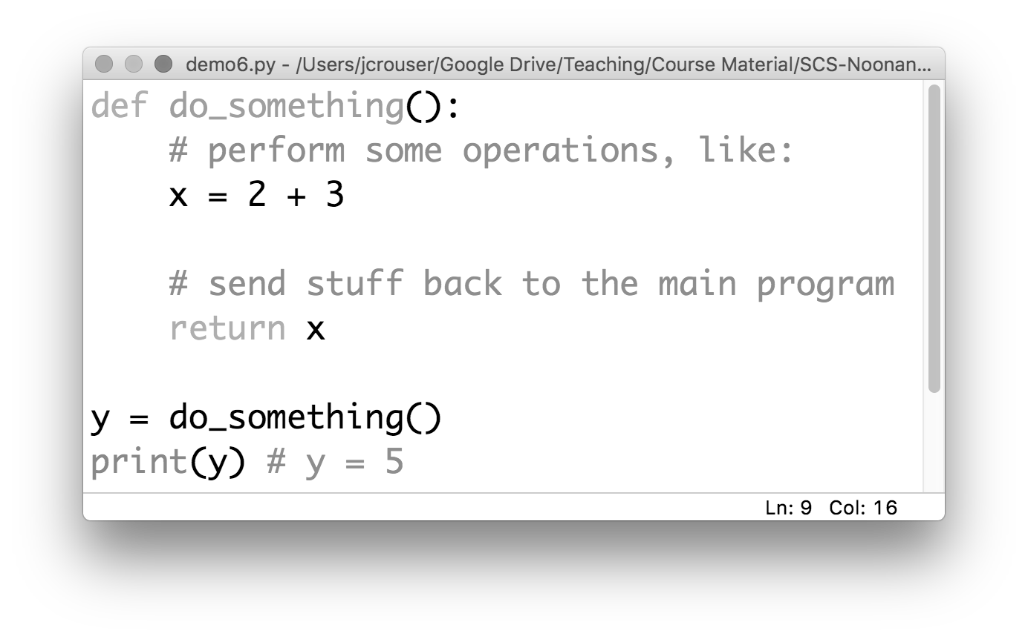
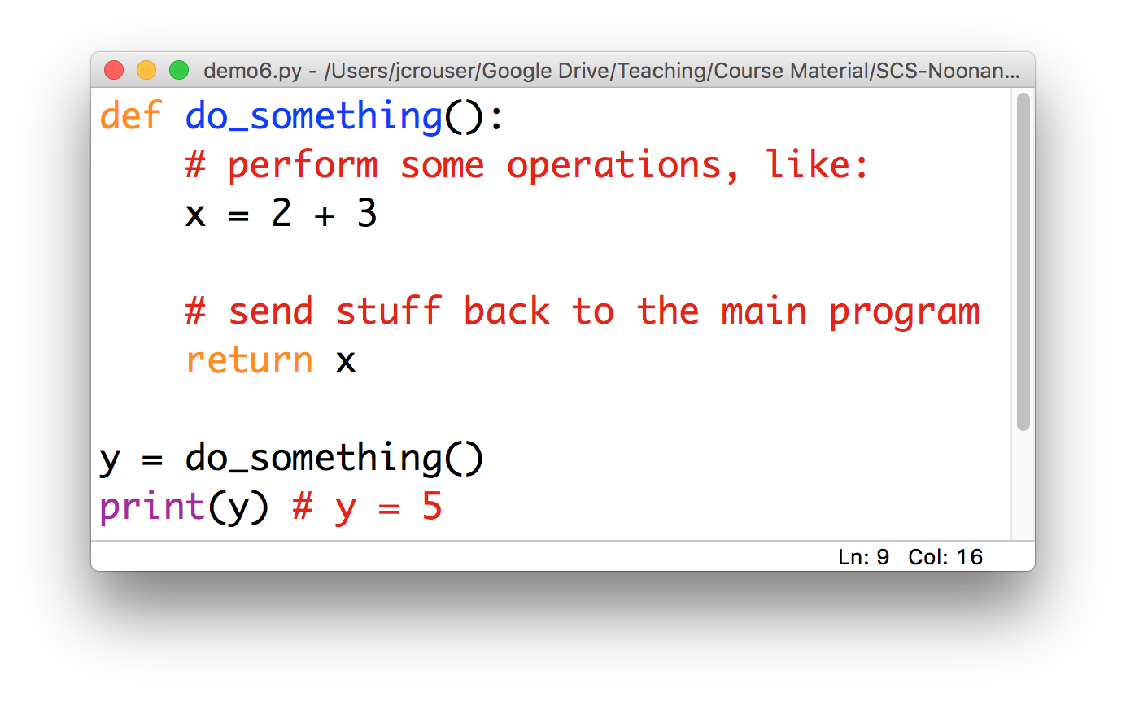
To recap: a “function definition”

Slide 6
To recap: a “function definition”
a name
Convention: use _underscores_ or camelCase

Slide 7
To recap: a “function definition”
defined using
the def keyword

Slide 8
To recap: a “function definition”
a body
(indented)

Slide 9
To recap: a “function definition”
a return (optional)

Slide 10
To recap: function calls
a function call

Slide 11
To recap: function calls
5

Slide 12
Definitions vs. calls
Function Definition
Function Call
Step-by-step instructions for how to perform a given set of operations
Analogy: a recipe
Think of the function’s name as shorthand (i.e. “okay, when I say do_something(), here’s what I want you to do”)
An actual request to perform the operations
Control is turned over to the “minion” (temporarily)
Once complete, we go back to the exact place in the program where the call was issued

Slide 13
Discussion
What does it mean for a function
to return a value?
And what’s the difference
between return and print(…)?

Slide 15
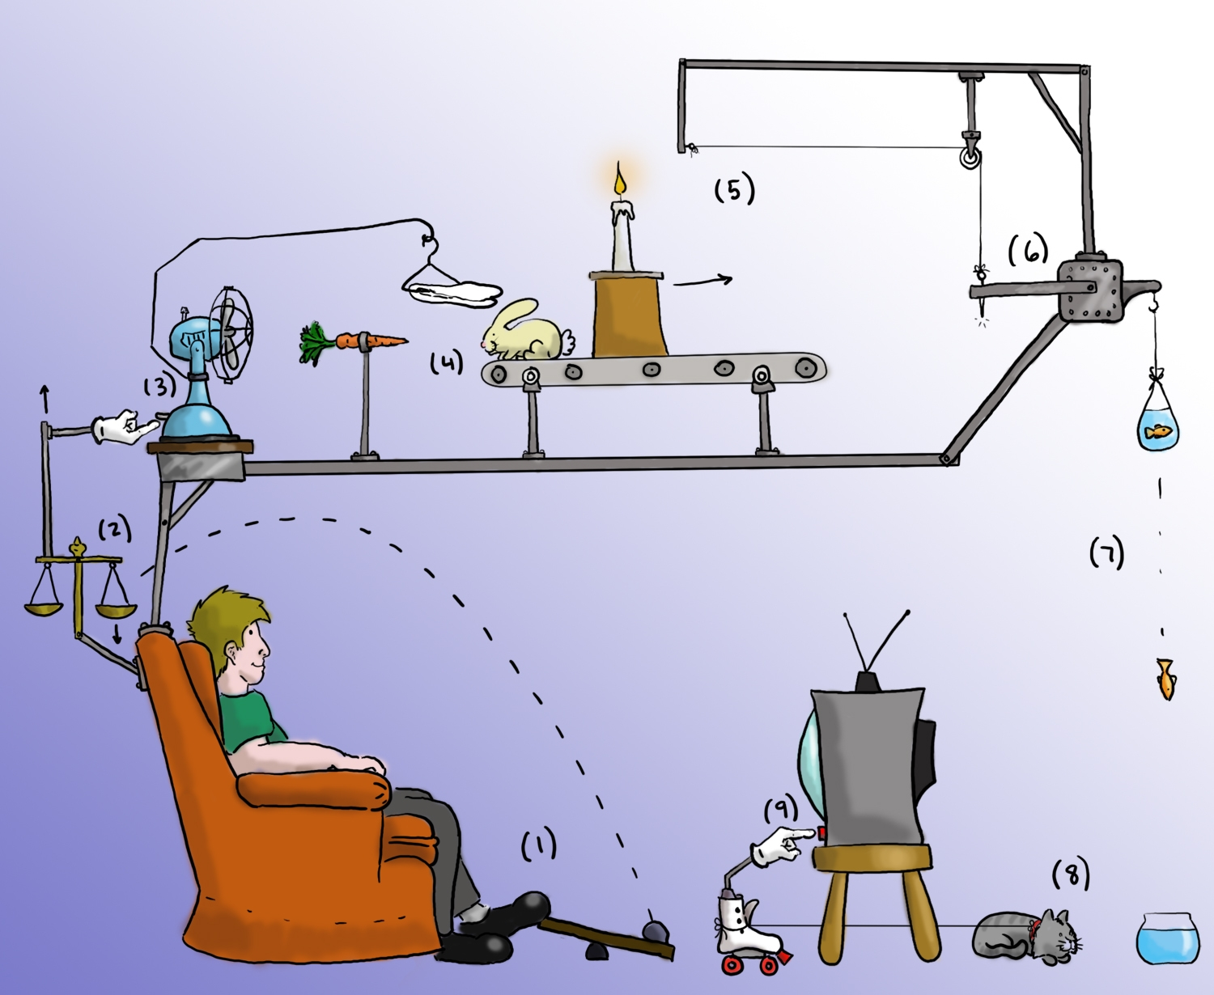
Demo: Rube Goldberg machine
“Remote” - by philister

Slide 16
def addOne(x):
Take the value of x, and add 1 to it
return the modified value

Slide 17
def doubleIt(x):
Take the value of x, and double it (i.e. multiply by 2)
return the modified value

Slide 18
def printWithStars(x):
Look at the value of x
Write it on the board in big letters
return nothing

Slide 19
def woohoo():
Say out loud a single, loud “WOO HOO!”
Call addOne(doubleIt(2))
return nothing

Slide 20
Discussion
Lingering questions?

Slide 21
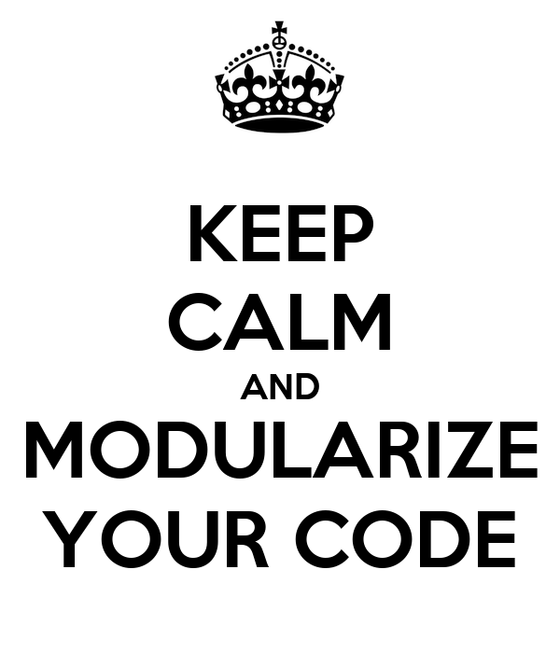

Slide 22
Takeaways
We’re now in the middle of week 5
(more than 1/3 way through the semester)
What can you do now
that you didn’t know how to do before?

Slide 23
Outline
Monday: first lesson in functions
Lab: wrapping up collections (lists, dictionaries)
Wednesday: more on functions
A4: Music Library due Thursday at 11:55pm
Friday: data structures comparison

